Slide 1

Deep Learning to Predict Housing Prices
Chris Taylor
DTSA 5511
University of Colorado at Boulder

Slide 2
Framing the Problem
Home is often a person’s largest investment
Over- or underpricing home could affect final sale price
Current process is inconsistent
Difficult to price home in unfamiliar district
Existing tools are opaque
Need to maintain some level of agent autonomy on pricing

Slide 3
Goal and Rationale
Develop a model that can be used to support real estate agents in evaluating the price of homes
Root mean squared error around $50,000 given most homes are priced in $50,000 intervals (e.g., $600,000)
Rationale
Increase inter-group consistency for evaluating the price of homes

Slide 4
How the Model Will Be Used
Prediction used as starting price of home
Adjusted based on agent’s evaluation of home
Assets
Newly renovated kitchen
Liabilities
Previous water damage
$$Starting Price+Assests −Liabilities=Final Sale Price$$

Slide 5
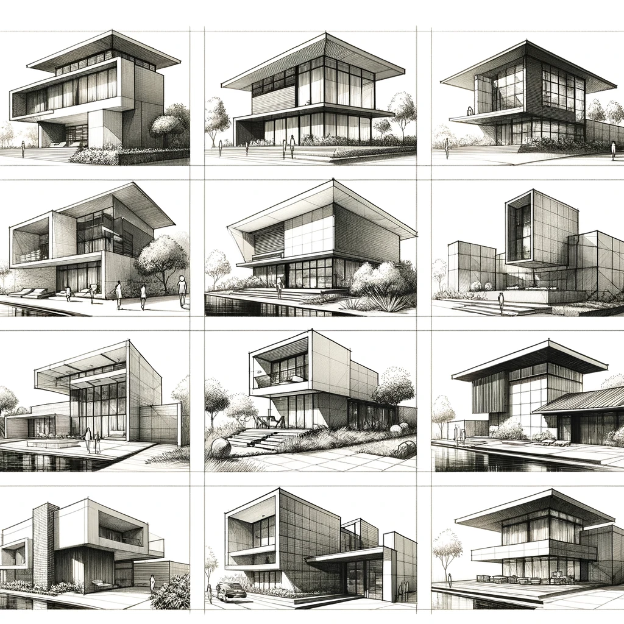
Dataset Features
Longitude
Latitude
Housing Median Age
Total Rooms
Total Bedrooms
Population of District
Households in District
Median Income
Ocean Proximity

Slide 6
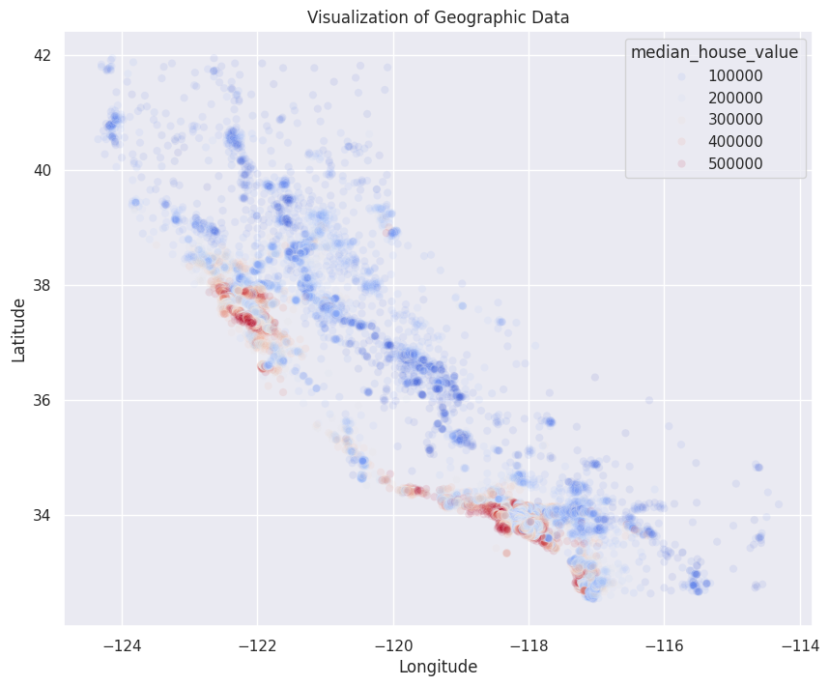
Geographic Data
Homes clustered by median home value
San Francisco
Los Angeles + coastal areas
San Diego

Slide 7
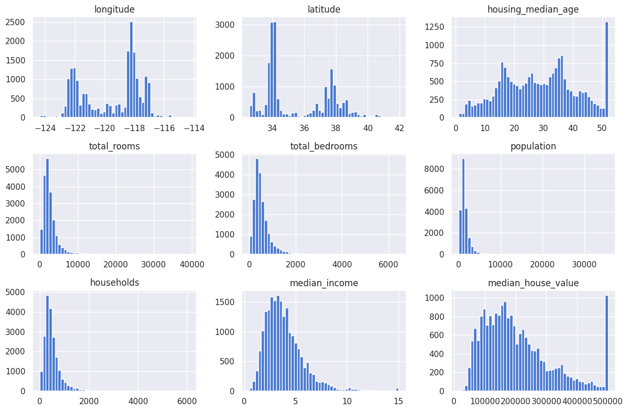
Distributions of Features

Slide 8
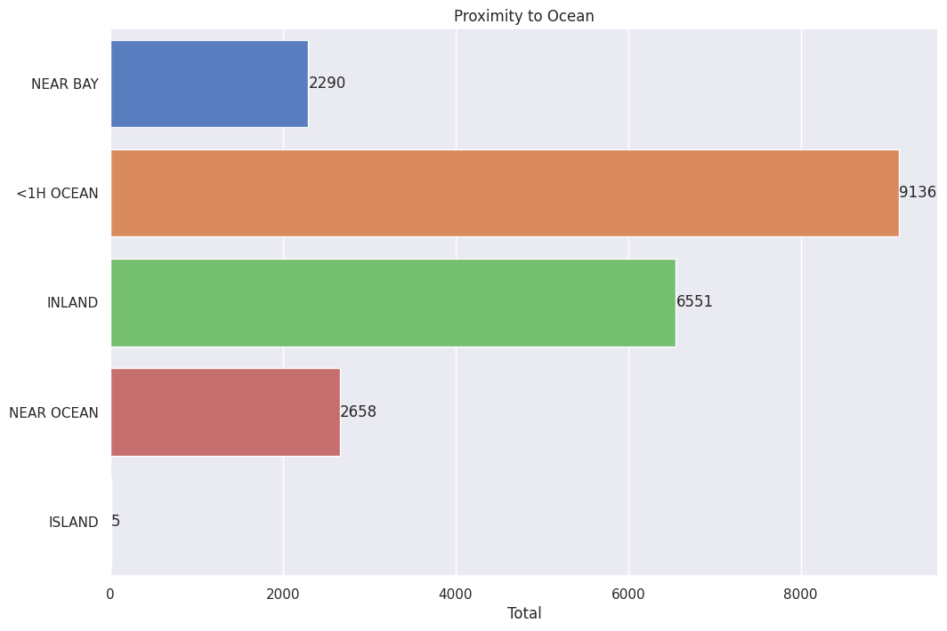
Proximity to Ocean

Slide 9
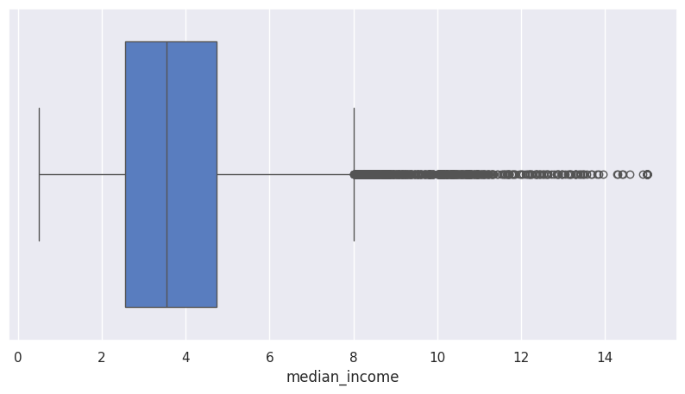
Bar Plot of Features

Slide 10
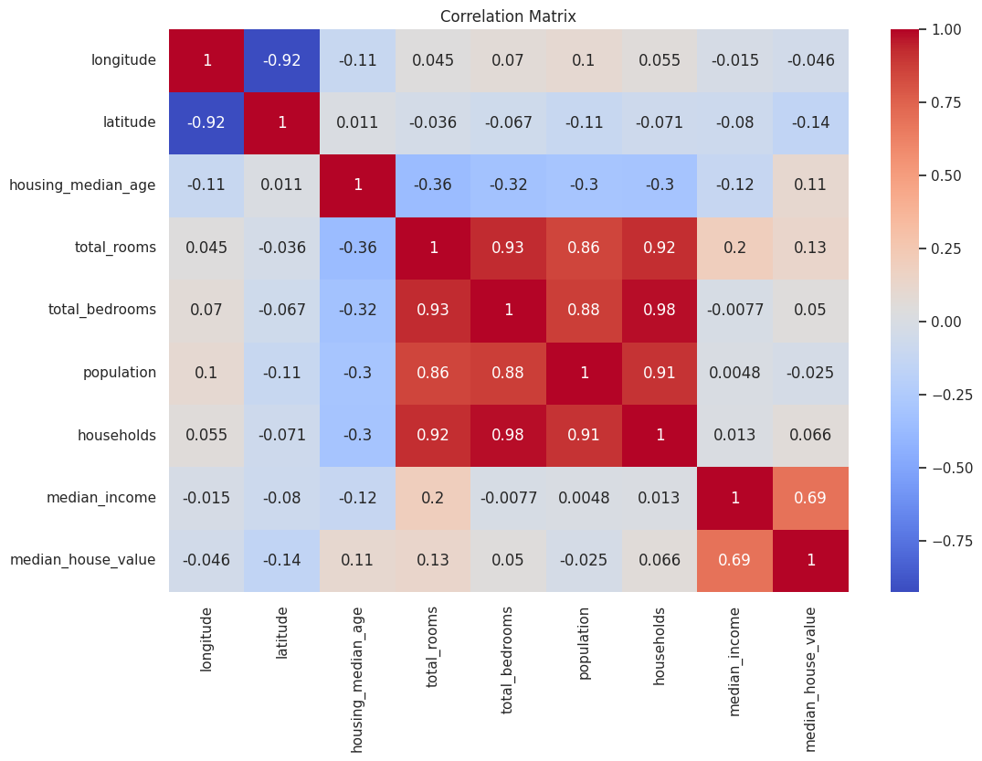
Correlation Matrix
Variable pairs with strong or very strong correlations
Total Rooms x Total Bedrooms
Total Rooms x Population
Total Rooms x Households
Total Bedrooms x Population
Total Bedrooms x Households
Population x Households
Median Income x Median House Value

Slide 11

Data Pipeline
Standard scaler transformation
Imputed missing data with median
One hot encoding for categorical variable

Slide 12

Methods Used
Three regression models using neural networks
Early stopping
Hidden Layers
Initializer proposed by He et al. (2015)
L2 regularization

Slide 13
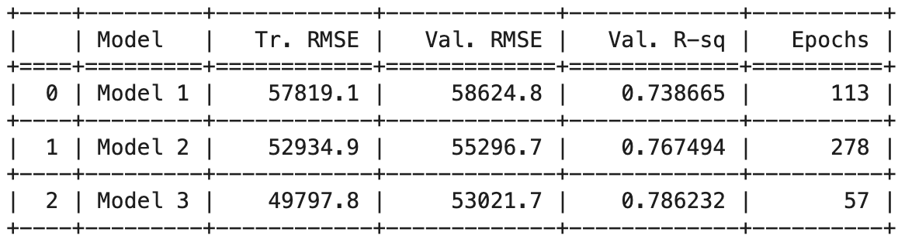
Model Comparison

Slide 14
Final Model – Deep Learning Model 3
Input Layer
Dense, 128, ReLU, L2
Dense, 64, ReLU, L2
Dense, 32, ReLU, L2
Output Layer
Runtime: 60 seconds
L2 regularization level = 0.2
Learning Rate = 0.05
Hidden
Layers

Slide 15
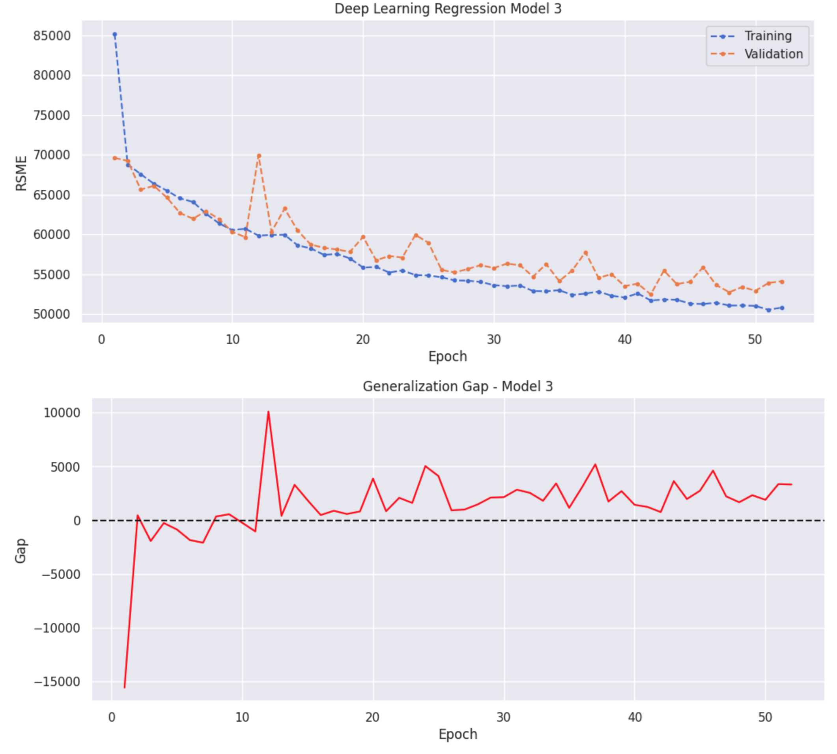
Observations/Notes
Weights restored from best epoch
Some overfitting

Slide 16
Hyperparameter Optimization
Optimized L2 regularization level
Evaluated levels
0.18
0.2
0.22
0.24
0.28
0.30

Slide 17
Final Model – Test Performance
Test Metrics
Test RMSE | $51,707.60
Normalized RMSE (NRMSE) | 10.66
Test R-Squared | 0.796

Slide 18
Conclusion
Goal Achievement: The target RMSE of approximately $50,000 was met by the best performing model
Given California’s geographic and economic diversity and the dataset’s outliers, NRMSE offers additional validity to the model’s utility
Limitations and Future Work

